Slide 1
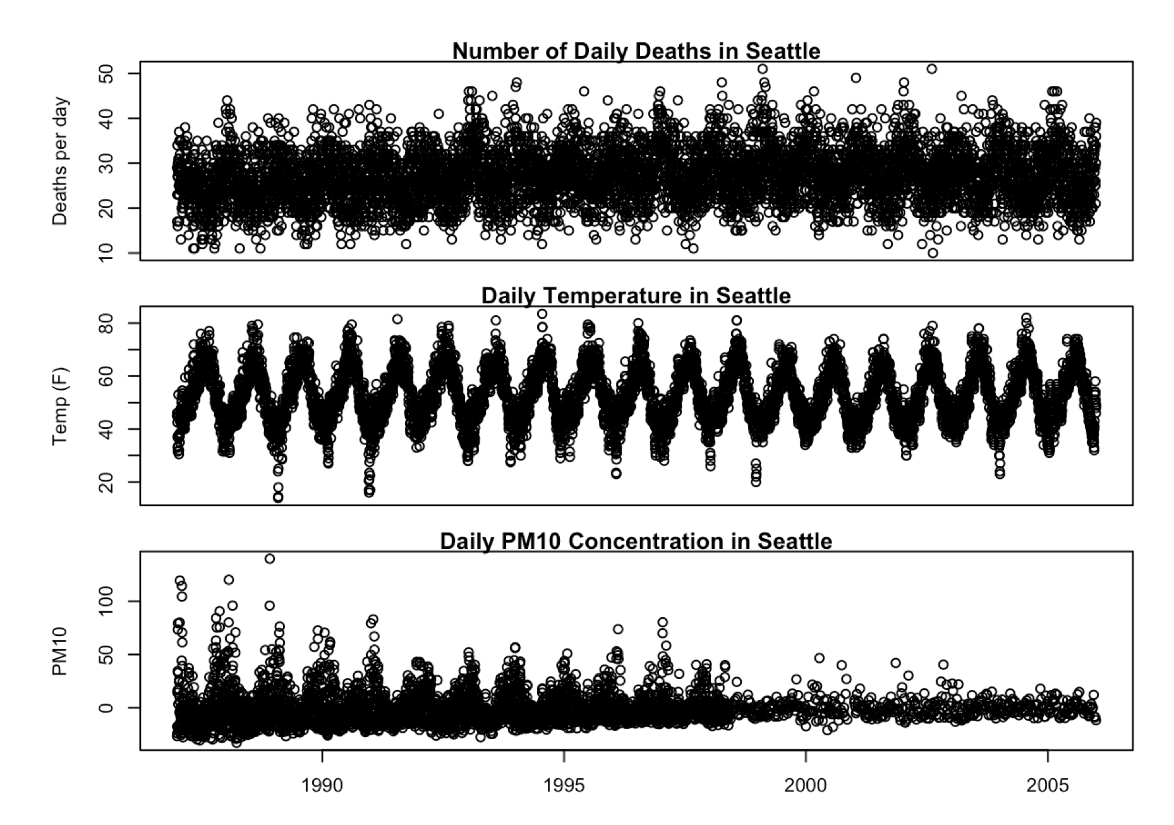

Slide 2
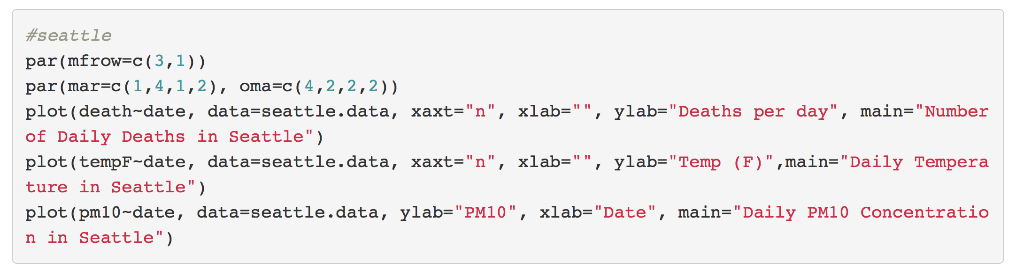

Slide 4
library(gridExtra)
Mortality<-den.data %>%
ggplot(aes(x = date, y = death)) +
geom_point(color="Dark Blue") +
labs(y = "Deaths", x = "")
PM10<-den.data %>%
ggplot(aes(x = date, y = pm10)) +
geom_point(color="Dark Green") +
labs(y = "PM10", x = "Date")
Temperature<-den.data %>%
ggplot(aes(x = date, y = tempF)) +
geom_point(color="black") +
labs(y = "Temperature", x = "")
labs(y = "Temperature", x = "")
grid.arrange(Mortality, Temperature, PM10,top="Deaths, Temperature (F), and PM10 concentration in Denver From 1985-2005", nrow=3)

Slide 6
PlotYvsX <- function(dataframe,x,y) {
aaa <- enquo(x)
bbb <- enquo(y)
dfname <- enquo(dataframe)
dataframe %>%
ggplot(aes_(y=bbb, x=aaa)) +
geom_point() +
ggtitle(bquote(.(bbb)~"by"*.(aaa)))+
geom_smooth(method = "lm") -> p
print(p)
}
Seattledeath <- PlotYvsX(seattle.data, date, death)
Seattlepm10 <- PlotYvsX(seattle.data, date, pm10)
Seattletemp <- PlotYvsX(seattle.data, date, tempF)
figure <- grid.draw(rbind(ggplotGrob(Seattledeath), ggplotGrob(Seattlepm10), ggplotGrob(Seattletemp), size = "last"))

Slide 7
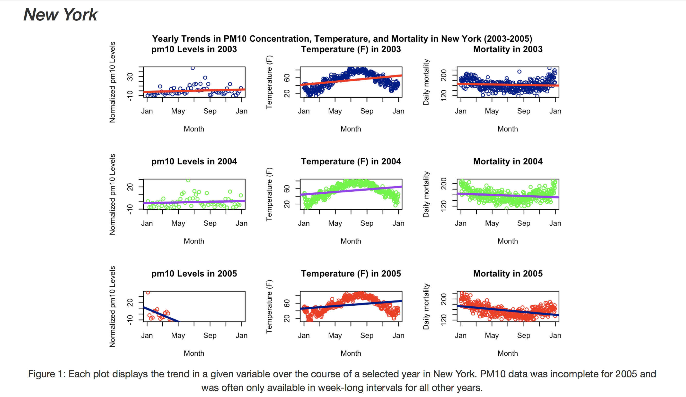

Slide 8
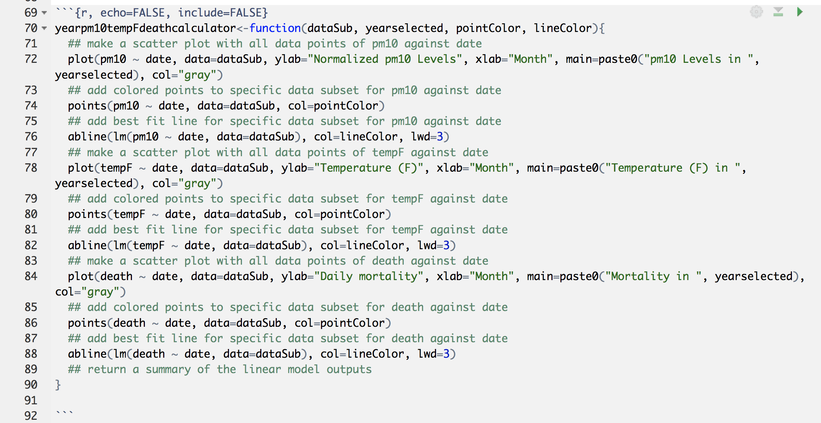

Slide 9
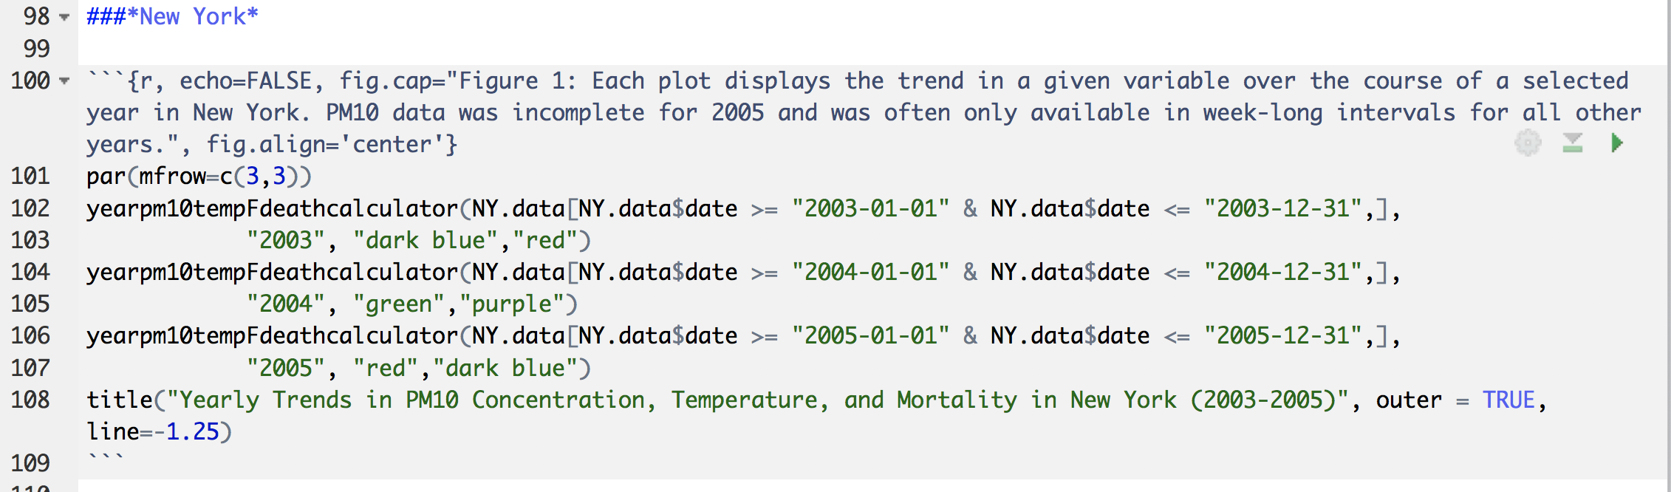

Slide 10
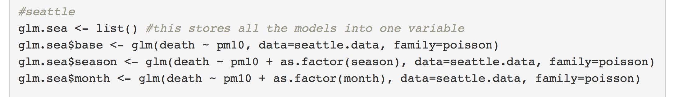
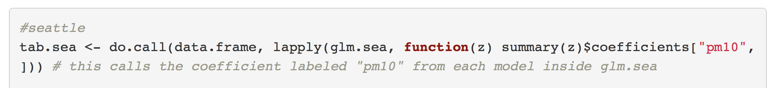
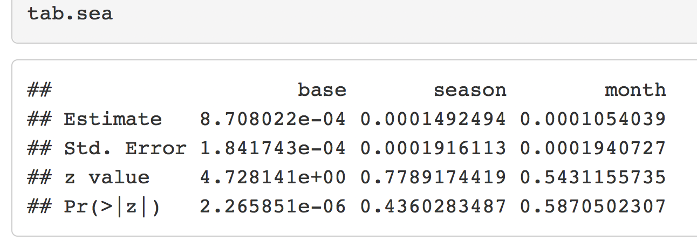

Slide 11
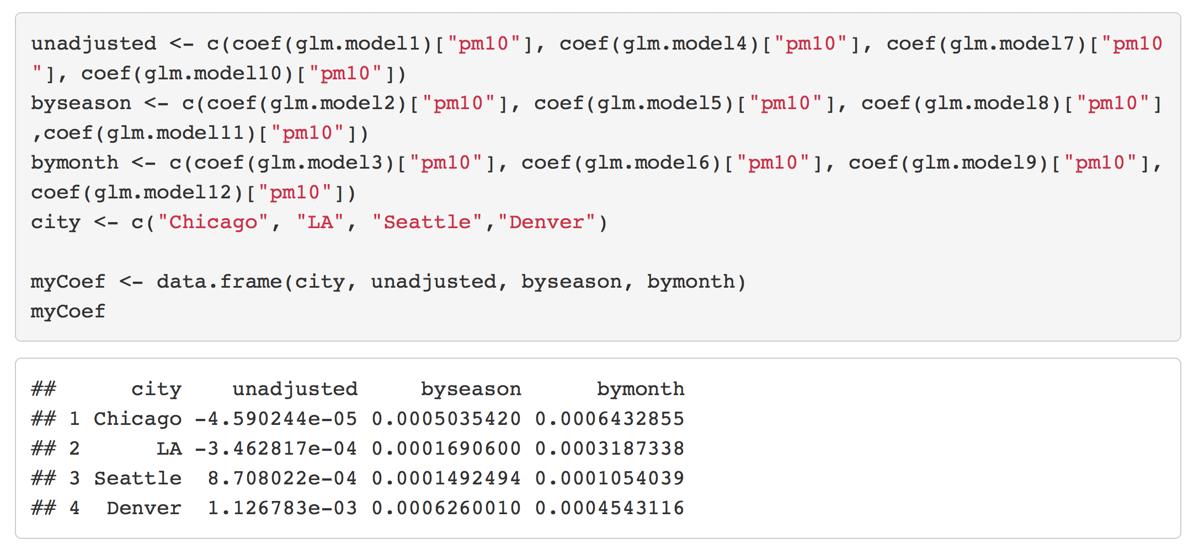
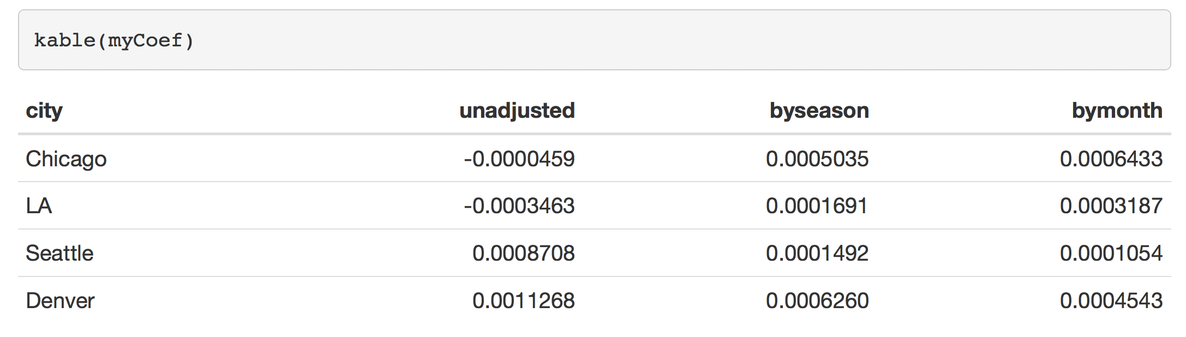

Slide 12
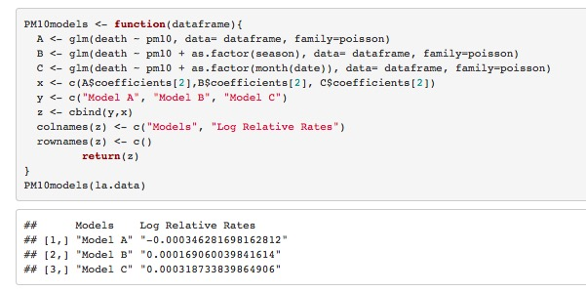

Slide 13
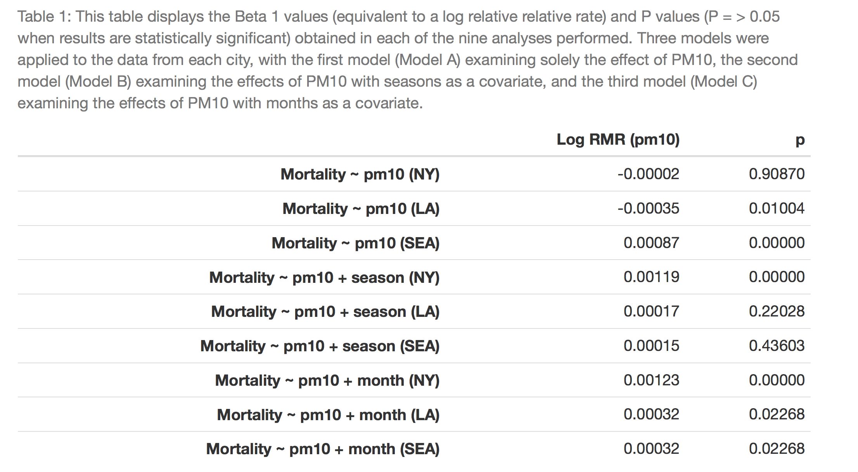

Slide 14
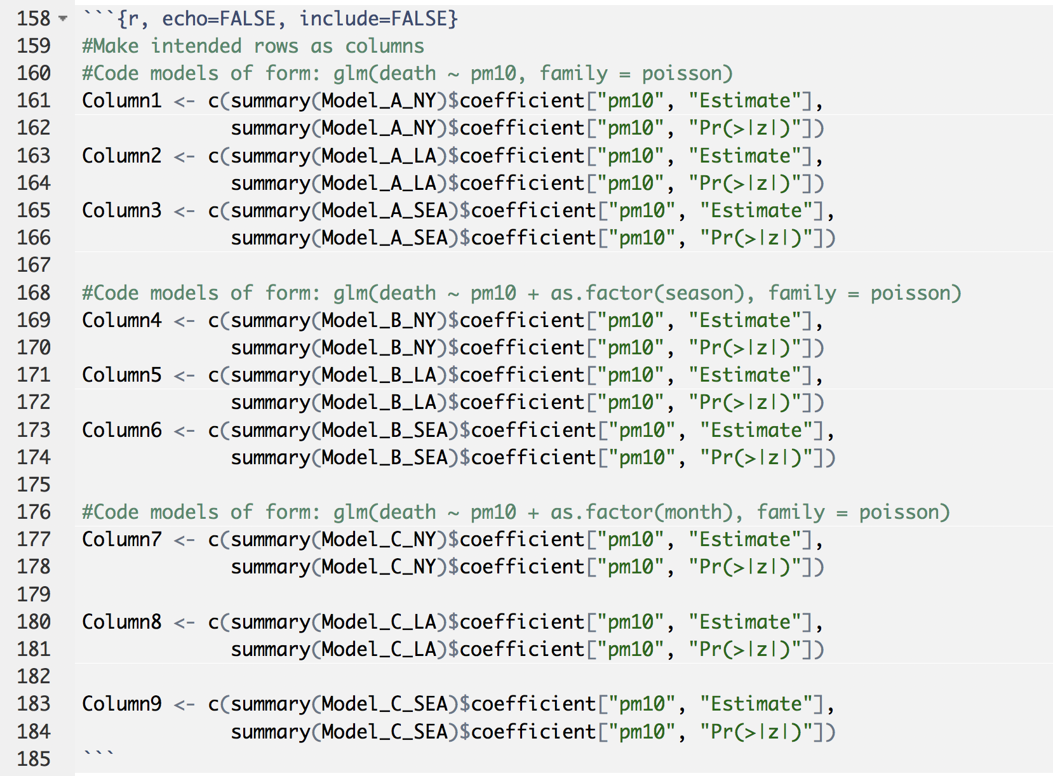

Slide 15
